Slide 1

The expansion of
Geographical Indications outside Europe: opportunities and challenges
Delphine Marie-Vivien et al delphine.marie-vivien@cirad.fr
CIRAD, UMR Innovation, F-Montpellier 34 398 Cedex

Slide 2
Sui generis GIs registered worldwide – (Jan 2024)
More than 8 600 worldwide (OriGIn database)
in the EU (228 for non EU GIs) (1536 for food products),
5370 in the EU
  3587 registered : 3461 for EU products,
  1783 foreign GIs with trade agreements
Over 400 in the ASEAN countries
73 in Japan
547 in India
1775 in China
63 in Brazil
70 in Mexico
62 in Morocco
464 in Turkey
Almost 200 GIs in Africa (88 for South Africa)
12 for OAPI countries

Slide 3



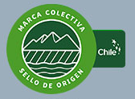
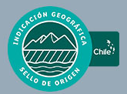


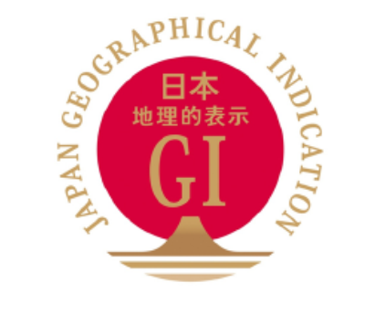

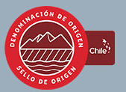







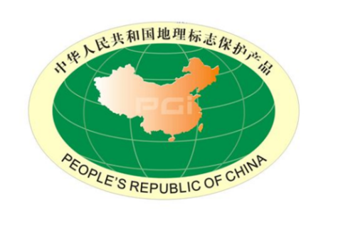
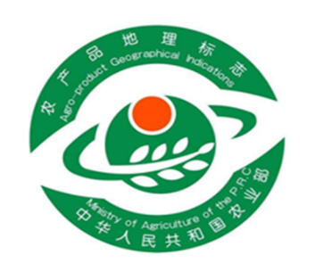
D.Marie-Vivien

Slide 4
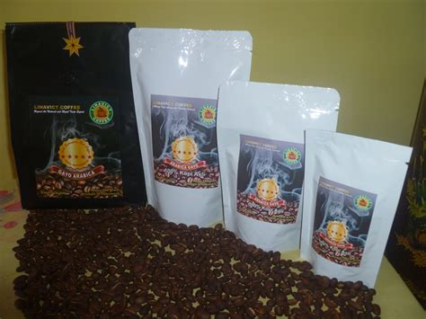

In Indonesia: Gayo arabica coffee
D.Marie-Vivien

Slide 5
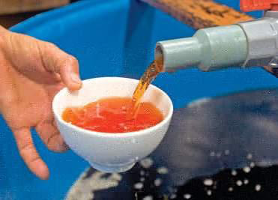
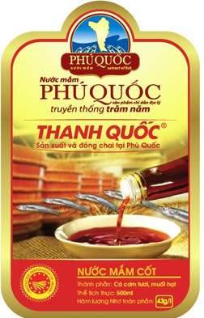
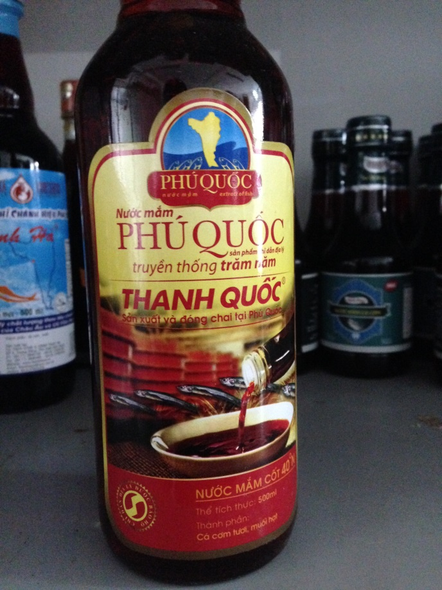
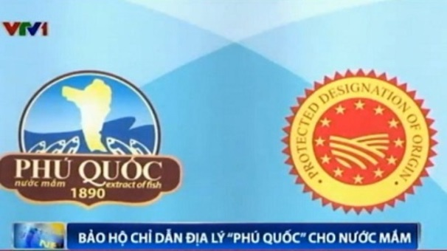
Viet Nam: Nước Mắm Phú Quốc
D.Marie-Vivien

Slide 6
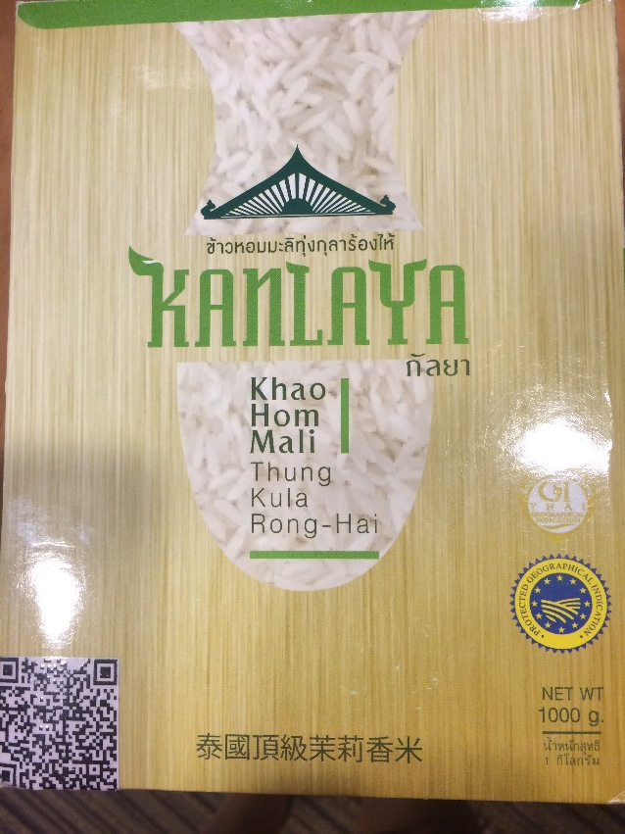

In Thailand: Khao Hom Mali Thung Kula Rong Hai (Rice)
D.Marie-Vivien

Slide 7
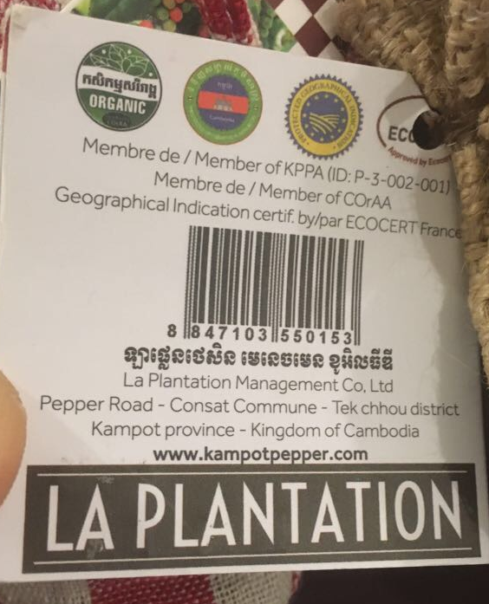
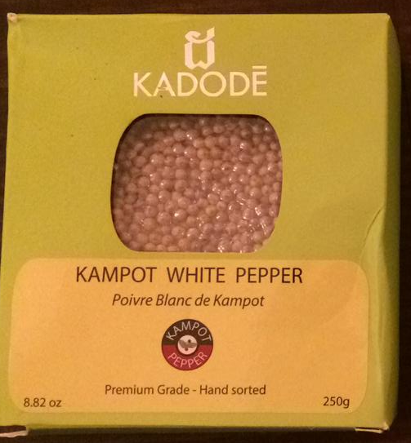
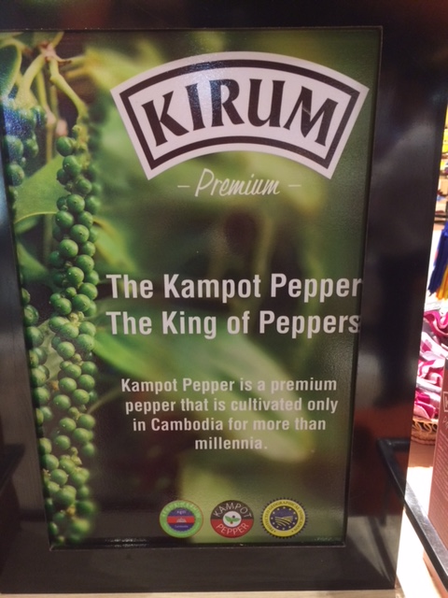
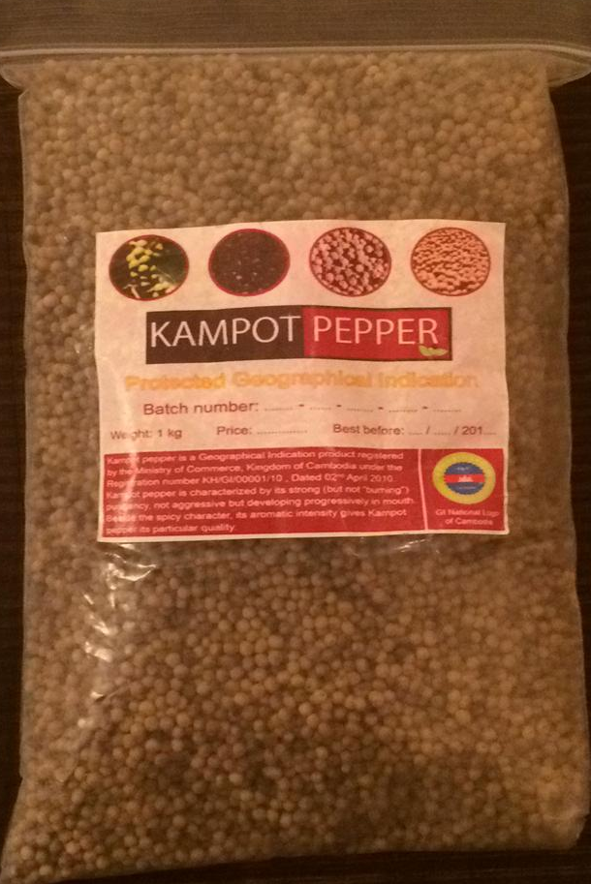
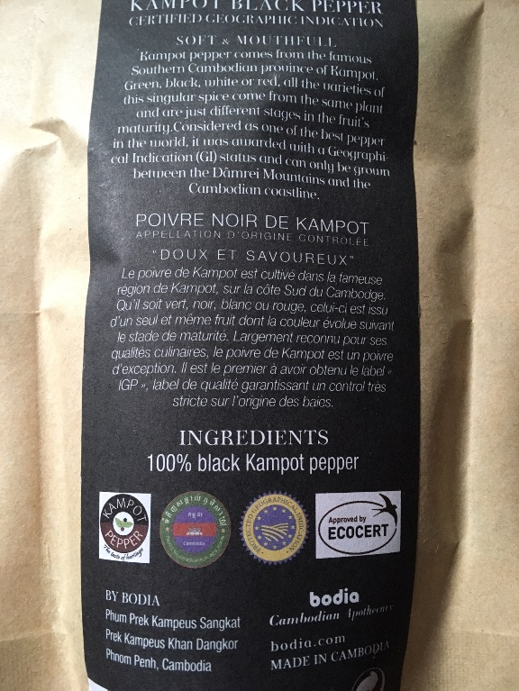
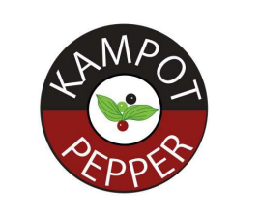
In Cambodia: Kampot Pepper
D.Marie-Vivien

Slide 8
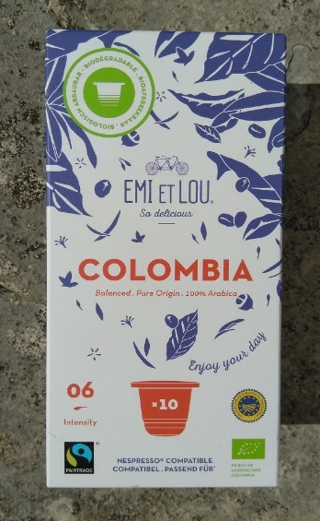

In Colombia: Café de Colombia
D.Marie-Vivien

Slide 9
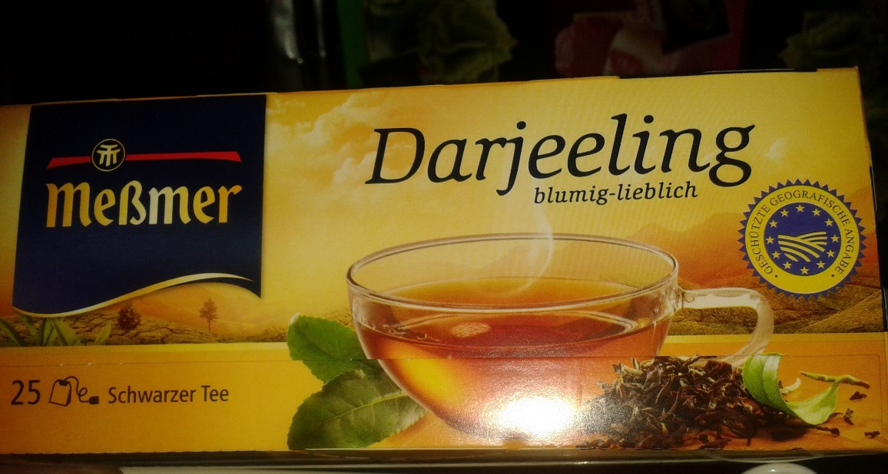
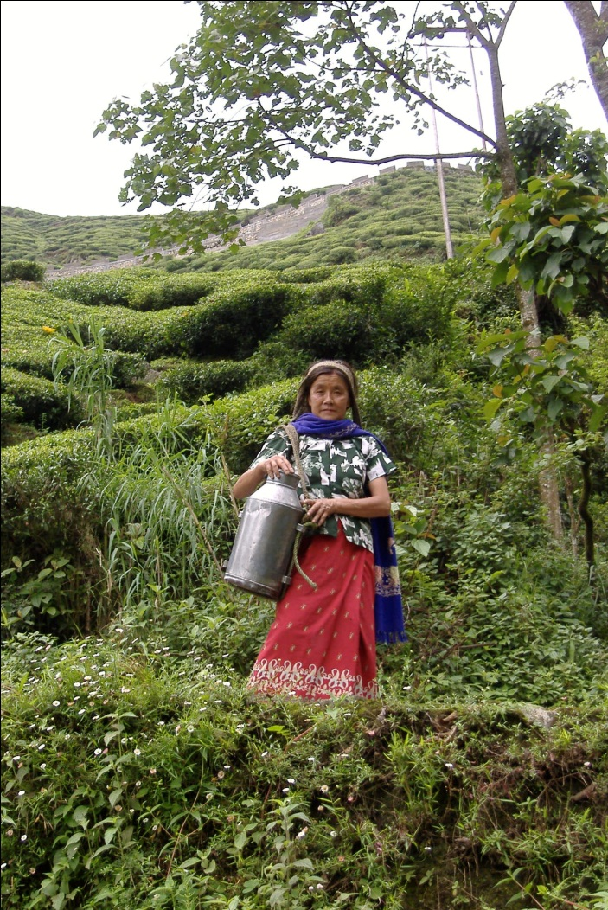

In India : Darjeeling tea
D.Marie-Vivien

Slide 10
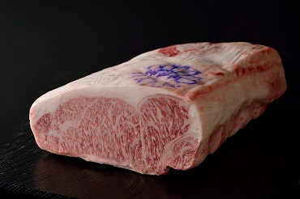
In Japan: Kobé beef
D.Marie-Vivien

Slide 11
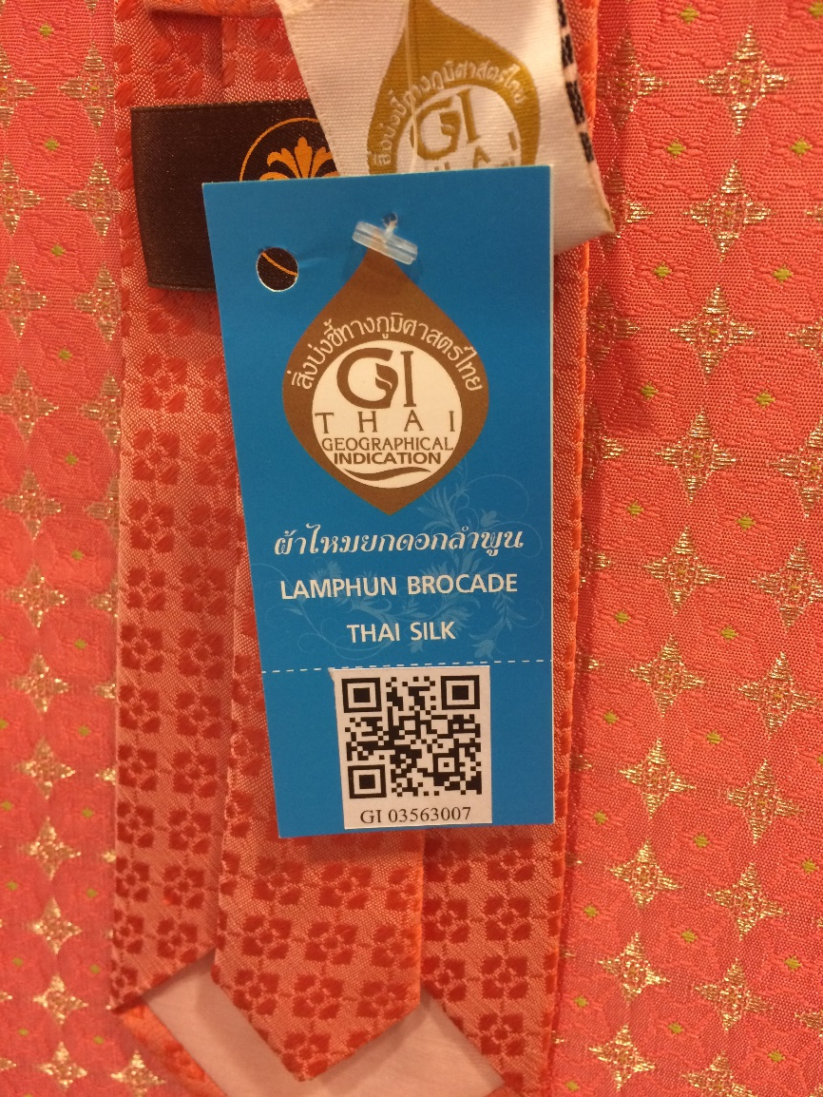
In Thailand: Lamphun Brocade Silk
D.Marie-Vivien

Slide 12
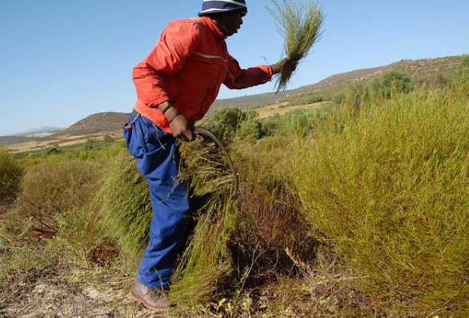
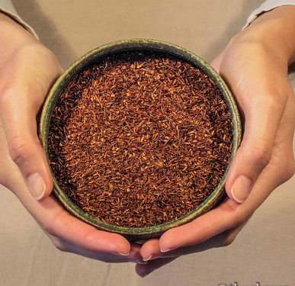

In South Africa: Rooibos
D.Marie-Vivien

Slide 13
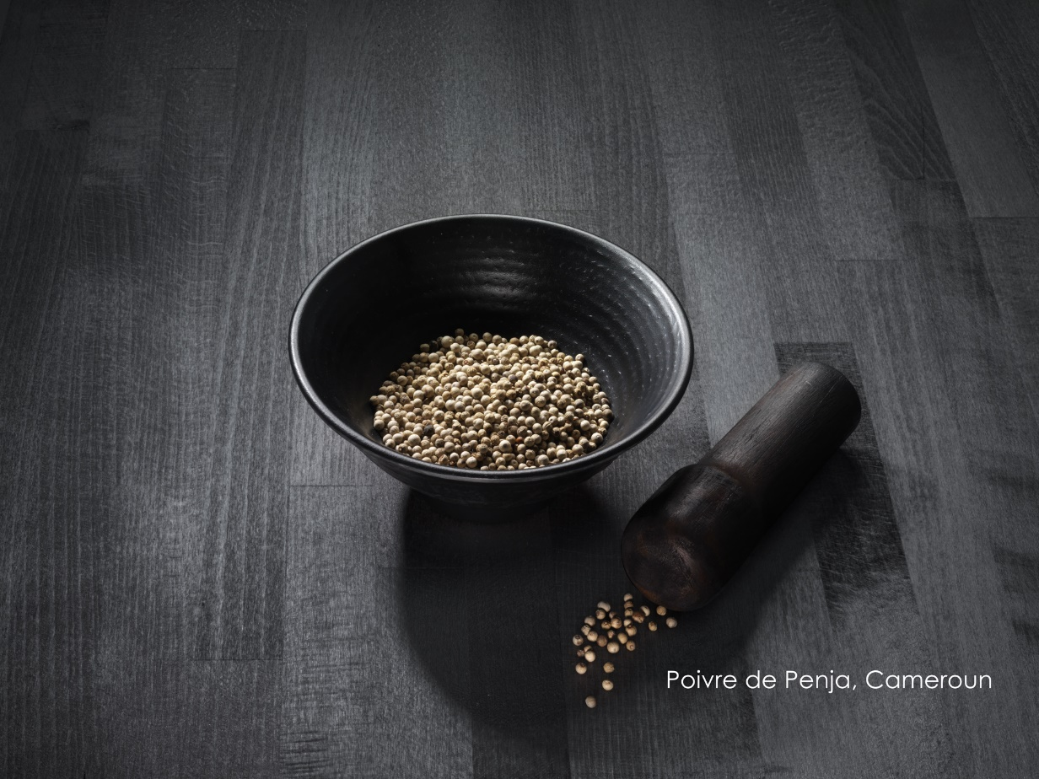
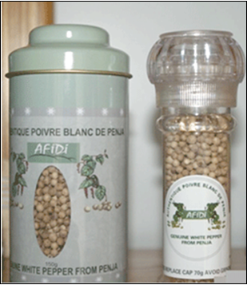
In Cameroon (OAPI): Penja Pepper
D.Marie-Vivien

Slide 14
Extension at the international level
TRIPs Agreement 1995
Most of countries in Asia, South America, North, West Africa and South Africa have sui generis GI laws
Geneva Act of the Lisbon Agreement (2015): 55 countries
  African Intellectual Property Organization (OAPI), Albania, Bosnia and Herzegovina, Burkina Faso, Cabo Verde, Cambodia, Congo, Costa Rica, Czech Republic, Côte d'Ivoire, Democratic People's Republic of Korea, European Union (EU), France, Gabon, Ghana, Hungary, Italy, Lao People's Democratic Republic, Mali, Nicaragua, Oman, Peru, Portugal, Republic of Moldova, Romania, Russian Federation, Samoa, Sao Tome and Principe, Senegal, Switzerland, Togo, Tunisia
But still a new legal concept

Slide 15
Some challenges :
Lack of use and control of GIs
In many countries in particular Asia: state driven top-down process
  by law both government institutions and producers groups apply for GI
  in practice majority of GIs filed by government institutions
Not enough involvement of GI producers who do not know a GI is registered
  GI specification not based on producers practices, sometimes too complicated
  No collective GI organizations of producers or only formed after GI registration
Issues
  Lack of use and controls of GIs
  Sleeping GIs…like the sleeping beauty!
  Need to strenghten GI producers associations

Slide 16
Some challenges : market access
GI a new concept for consumers / buyers :
  GIs on unknown names: need to create a reputation, find buyers
  GIs on reputed name: need to exclude those not complying with the GI specification
Importance of a premium
  To valorize the quality

Slide 17
Some challenges : kind of products
GIs for intermediate products such as green coffee (green beans)
  The final product for consumers being produced outside the geographical area of cultivation of coffee
  no rules on roasting process = no control on the final of quality
  governance of the GI: no shared interest and common discussions among all stakeholders
  Difficult to access markets

Slide 18
Conclusions
Success of the internationalization of the sui generis GI European concept
Many GIs registered in their home country and in export countries
Need to strengthen the collective action of value chain actors:
  To have the GIs active
  To have strong management of the quality
  EU/French producers to support through sponsoring?

